Slide 1
Firm Profile
Address: House 07, Level 5, Road 137/141, Gulshan 1, Dhaka 1212
Email: info@arccabd.com
Web: www.arccabd.com
Phone: +880255045267-68
Hotline: +8801724166730
& +8801645193991

Slide 2
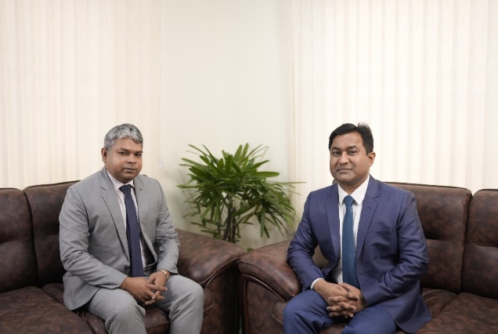
About Us
Adhikari Roy & Co (ARC) is a Chartered Accountancy firm established by Mohan Adhikari, FCA, and K D Roy, FCA (ICAB), ACA (ICAEW). Mr Adhikari completed his CA final in 2015 and began his audit practice in 2017 as a partner at Pinaki & Company, Chartered Accountants. On the other hand, Mr Roy qualified CA in 2010 and started his tax practice with A K Chowdhury Sir, Co-founder & Managing Partner of Hoda Vasi Chowdhury & Co. (formerly Deloitte Bangladesh) and later became a partner in 2016 at Pinaki & Company, Chartered Accountants. Mr Roy also served as Lead Tax Partner and Branch in Charge at Masih Muhith Haque & Co., Chartered Accountants (RSM in Bangladesh) for three years. Together, both partners established ARC to provide comprehensive and sophisticated professional services, distinct from general statutory audit and assurance services.
The ARC team comprises 65 CA article students, one director (FCMA), 20 partly qualified CA Managers, 10 administrative officers and additional staff, making a total of 100 professionals.

Slide 3
ARC’s Scope of Services at a Glance
Audit & Assurance
Licensed from ICAB
All statutory audits
Govt. Audit
NGO Audit
University Audit
Hospital Audit
Religious / Charitable Trust
Firm Audit
Airlines Audit
Management audit
Financial Due Diligence
Cost Audit
Internal Audit
Performance Audit
Financial Investigation
Compliance Audit
Branch & Liaison Office Audit
Project Office Audit
Financial Health Check Up
FRC Enlisted
NGO Affairs Bureau Enlisted
NBR listed Members
Bangladesh Securities and Exchange Commission Enlistment Members

Slide 4
ARC’s Scope of Services at a Glance
Income Tax
Corporate VAT
Customs Duties
Personal Income Tax
Corporate Income Tax
Expatriate Taxation
Appeal, Tribunal, ADR
Tax Due Diligence
Transfer Pricing
Tax Advisory Services
Tax Management Consultancy
Tax Waiver Certificate
Income Tax Clarification
SRO etc.
Monthly VAT Return
VAT Books of accounts
BIN Registration
VAT Audit Assistance
VAT Refund
VAT Agent
Duty drawback
Appeal, Tribunal & ADR
VAT Clarification,
CT Adjudication,
VAT Show Cause reply & hearing,
VAT Consultancy
SRO, etc.
Bond License
Identifying HS Code(S)
Apply CKD / SKD importation.
Applying for & exemption for temporary importation.
Applying the duty drawback.
Appeal/Tribunal ADR
Applying for WRIT petition/ Stay Order etc.
VAT Solutions
Tax Appeal
Tax Tribunal
Tax Optimization

Slide 5
ARC’s Scope of Services at a Glance
Branch Office, Project Office and Liaison/Representative Office
Accounting
Regulatory
Payroll Services
Book-keeping
Monthly Accounting
Monthly MIS Report
Accounting Manual
Chart of Accounts
Annual Accounting
FDI Reporting
BPO Services, etc.
Setting up Company
Setting up Branch Office
Setting up Liaison Office
Setting up Firm
Setting up Trust, NGO
RJSC return Filling
Secretarial Services
IRC & ERC
Trade License
Environmental Clearance,
Fire License
Work Permit, BIDA Registration
Visa Immigration Services,
Trade mark Registration
Valuation Services
etc.
Work permit and VISA for foreign expertise…
New Company Registration…

Slide 6
Organization Strengths
Established
No. of Offices
Office space
Professionals
Computer equipment
Vehicle
01 November 2022
One Offices:
Registered office
Corporate office: 3,200 Sq./ft. with parking facility for clients.
02 FCA, 01 FCMA, 01
Barrister, 65 CA Article Student, 15 Partly Qualified CA/ CMA/ ACCA and 15 ITP and other Professionals:
Total 100.
70 Laptops, 2 Pcs , 1 Photocopy Machine, 3
Scanners, 6 printers along with the highest speed Wi-Fi.
04 Cars & 02 Motorcycle

Slide 7
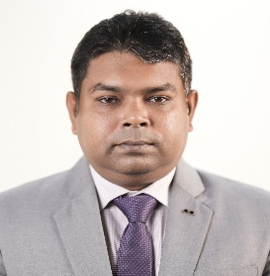
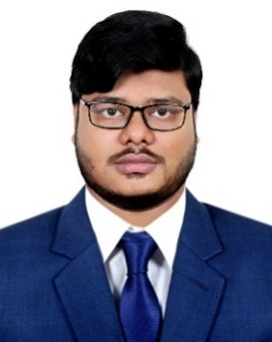
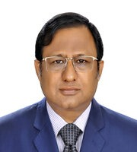
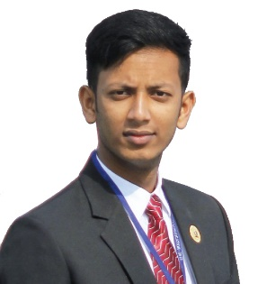
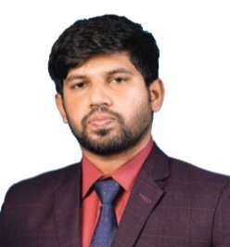
Mohan Adhikari, FCA
Audit Partner
Team
Composition
(Audit & Assurance)
Md. Al-Amin Chaklader
MBA,
CA, Partly Qualified (Professional Level)
Sr. Manager (Audit & Assurance)
Debabrata Deb Roy
MBA, FCMA
Director -Audit & Assurance Services
Akash Kumar Pramanik
MBA, CA Partly Qualified
Manager (Audit & Assurance)
Md. Hafijur Rahman Riad
MBA, CA, Partly Qualified
(Professional Level)
Manager
(Audit & Advisory Service)

Slide 8
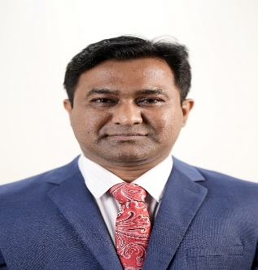
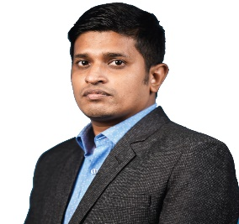
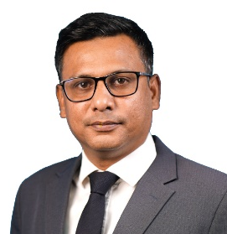
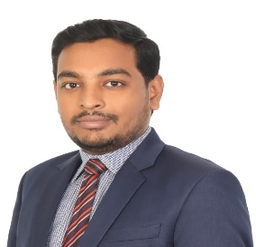
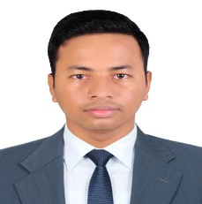
K D Roy, FCA(ICAB),ACA(ICAEW)
Tax Partner
Team
Composition
(VAT, Tax & Legal Team)
MD. Nurunnabi Chowdhury
BBS, MBA, L.L.B ,CA, Partly Qualified
Sr. Manager
(Tax, VAT & Regulatory Affairs)
Pritam Das
BBA, MBA CA Partly Qualified Manager (Tax, VAT Affairs)
Obaidur Rahman,
MBS, LL.B, ITP
Manager (Tax Circle Office)
Md. Sabbir Hossain,
BBA, MBA, CA Partly Qualified
(Professional Service)

Slide 9
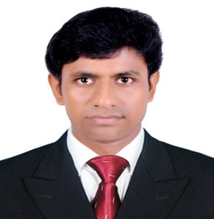
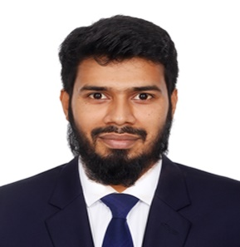
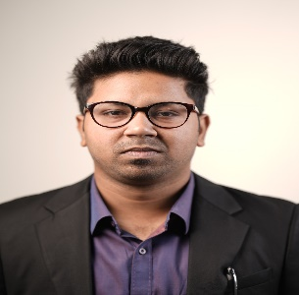
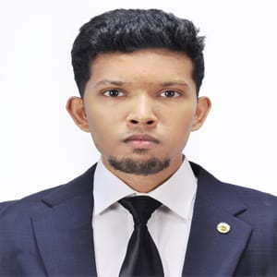
Mohan Adhikari, FCA
Audit Partner
Team
Composition
(BIDA Affairs, Company Secretarial services & Other regulatory services)
Dhruba Karmakar, LLB
Manager
(BIDA & Other regulatory services)
Md. Rashed Chawdhury
BBA, MBA, CA. CC (Professional Level)
Manager (RJSC & Others Regulatory)
Deep Chandra Das
Deputy Manager
BIDA & Other regulatory services
Ibrar Hossain
Executive Officer (Admin)
Administration & Other regulatory services

Slide 10
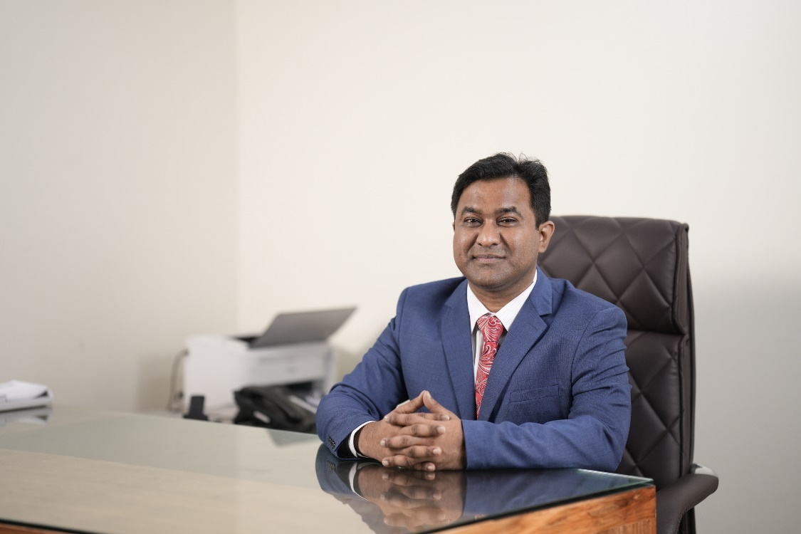
CURRICULUM VITAE OF ARC’S KEY PERSONS

Slide 11
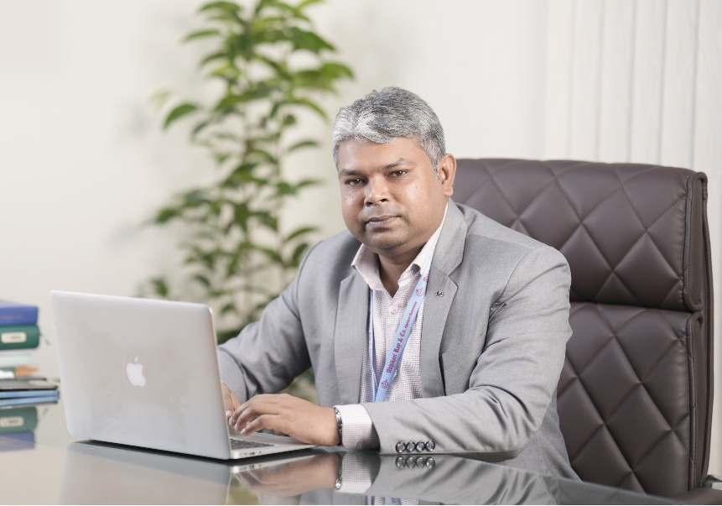
Experience:
Present: Audit Partner, Adhikari Roy & Co., Chartered Accountants (November 2022 to Present)
Previous Experiences:
Partner of Pinaki & Company, Chartered Accountants (March 2017 to October 2022)
Assistant General Manager (Finance & Accounts) Ha-Meem Group, a largest RMG Sector in Bangladesh
(December 2014 to February 2017)
Assistant Manager (Finance 7 Accounts) Bangladesh Freight Forwarders Association (BAFFA)
(June 2011 to December 2014)
Chartered Accountancy article ship Course (June 2008 to May 2011)
Professional Membership:
Fellow Chartered Accountant (FCA) under the Institute of Chartered Accountants of Bangladesh (Enroll No. 1729).
Enlisted in National Board of Revenue (NBR) as an Income Tax Practitioner (ITP) bearing registration no. 10744.
Enlisted in National Board of Revenue (NBR) as a VAT Consultant bearing License no. C202256
Member of Professional Club Limited (Membership no. 0199)
Mohan Adhikari, FCA
Audit Partner
14 Years exprience in the field of Tax, VAT and other fiscal issues of Bangladesh.
Hotline: +8801724166730
+880255045267-68
Email: mohan@arccabd.com, mhnadkr@gmail.com
Website: www.arccabd.com
Educational Qualifications:
M.Com–Master of Commerce major in Accounting from National University.
Training:
Eight weeks course on General English at the level of “Intermediate 1 (B1-1)” under British Council, Bangladesh.
Six months training course on “Basic Computer Course” Organized by Department of Youth Development under Ministry of Youth & Sports.
Attended conferences, seminars and workshops on professional matters. Regular attendance at Continuing Professional Development (CPD) program of the Institute of Chartered Accountants of Bangladesh (ICAB).
Dummy Audit Working Paper Files for Discussion and Comments Organized by ICPE.
Specializations:
Audit & Assurance, IFRS, ISA, Corporate and Individual Tax Assessment and Foreign Company setting up in Bangladesh & Business Registration & Licensing.
Travelling:
UK, USA, Dubai, Thailand, Malaysia, Singapura, Maldives, India

Slide 12
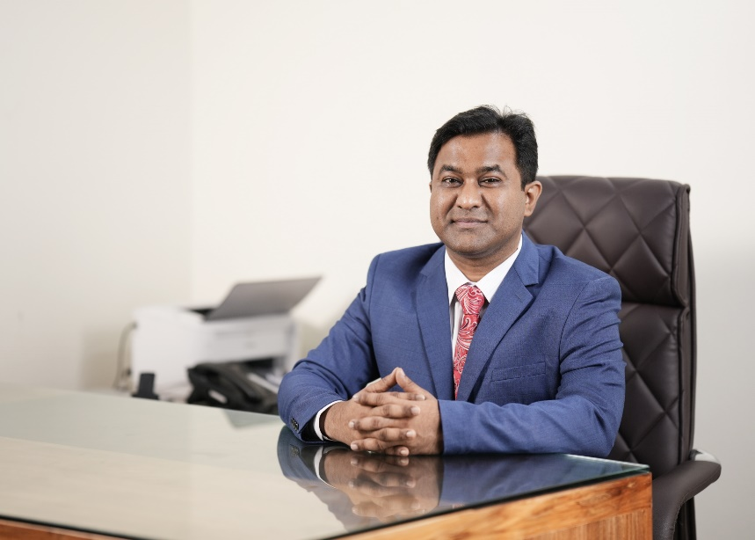
Experience:
Mr. Roy is a practicing Chartered Accountant with extensive experience as a tax adviser for numerous national and multinational organizations, including KAFCO, United Hospital, Pathao Limited, Reckitt Benckiser, Save the Children, Dell-EMC, Oxfam, Pathfinder, Everest Pharmaceuticals PLC, icddr'b, AL Muslim Group, and SR Group, among others. He has also served as an independent consultant for Deloitte, PwC, and EY. Notably, Mr. Roy worked directly with Mr. A. K. Chowdhury, FCA Co-Founder & Managing Partner of Hoda Vasi Chowdhury & Co. (formerly Deloitte Bangladesh, A. F. Ferguson & Co.) for eight years.
Mr. Roy is expertise in Corporate Tax assessment; First Appeal & Appellate Tribunal, Alternative Dispute Resolution (ADR), Personal & Expatriate Taxation Service Out-bound Taxation Services, Assessment of Foreign Investment Fund, newly adopted Transfer Pricing, Tax Due Diligence; Financial Due Diligence, Forensic Services, Regulatory Services and Advisory services in relation to the Income Tax Ordinance 1984 (Act no. 36 of 1984), Double Taxation Avoidance Agreement (DTAA), The VAT & S D Act (Act no. 47 of 2012) 2012, Customs Act (Act no. 04 of 1969) 1969, The Companies Act (Act no. 18 of 1994) 1994, Foreign Exchange Regulation Act (Act no. 07 of 1947) 1947, Bangladesh Labour Act (Act no. 42 of 2006) 2006 read with Bangladesh Labour (Amended) Act (Act no. 30 of 2013) 2013 and other emerging related laws.
K D Roy, FCA (ICAB), ACA (ICAEW)
Professional Membership:
Fellow Member of the Institute of Chartered Accountants of Bangladesh (ICAB), 2010 (FCA 1230).
Associate Member of the Institute of Chartered Accountants of England & Wales, 2022 (ACA 41159866)
Member of Dhaka Taxes Bar Association (DTBA) - K-00518.
Certified VAT Agent of NBR (VAT Agent Certificate Number) : 14/2019
Listed VAT Consultant (Sl. # C202037) of NBR, Bangladesh.
Member International Fiscal Association (IFA 62700)
Tax Partner
19 years experience in the field of Tax, VAT, and other fiscal issues of Bangladesh.
Hotline: +8801724166730
+880255045267-68
Email: kdroyca@arccabd.com &
kdroyca@gmail.com
Website: www.arccabd.com
Educational Qualifications:
M Com–Master of Commerce major in Accounting from Jagannath University.
B Com– Bachelor of Commerce from Tejgoan College under National University.
Publications
The Income Tax Ordinance 1984 (Year: 2022-23)
TDS VDS Booklet (Year: 2022-23)
TDS VDS Booklet (Year: 2023-24)
TDS VDS Booklet (Year: 2024-25)
Specializations:
Tax, VAT, Corporate Laws, Foreign Direct Investment, BPO, Due Diligence, Forensic Services etc.
Travelling:
India, Dubai, Sri Lanka, Singapore, Malaysia.

Slide 13
Experience:
Mr. Mr. D D Roy is a Fellow of the Cost & Management Accountant with extensive experience working for foreign companies in Dubai and overseas. He has served as the Group Finance Director of a leading Advertising Group in Bangladesh, Asiatic 360 Group, for over twelve years. Mr. Roy has a long history of working in finance, accounting, costing, and internal control departments within manufacturing entities. He possesses expertise in statutory and cost audits, valuation services, financial due diligence, accounting services, VAT and tax consultancy, as well as various computerized accounting packages including ERP solutions (SUN, Oracle 11i – AR, AP, Cash Management, GL, Fixed Assets), Focus, etc.
Professional Membership:
Fellow Member of the Institute of Cost and Management Accountants of Bangladesh (ICMAB), 2012 (F 0675).
Member of Dhaka Taxes Bar Association (DTBA)-D-0199.
Educational Qualifications:
MBA major in Finance from International Islamic University Of Chittagong.
B Sc– Bachelor of Science under University of Chittagong.
Industry Experience:
Technology & Media
Advertising Company, Foreign Company
Manufacturing, Land Development Company
Telecommunications
Debabrata Deb Roy, MBA, FCMA
Director -Audit & Assurance Services
25 Years exprience in the field of
Cost & Management issues of Bangladesh.
Hotline: +8801724166730
+880255045267-68
Email: debabrata@arccabd.com
ddroycma@gmail.com
Web: www.arccabd.com
Specializations:
Statutory audit, Cost Audit, Assurance, Valuation, Accounting, Internal Audit, etc.
Travelling :
India, Dubai, Saudi Arabia, Singapore, Thailand, Malaysia, etc.

Slide 14
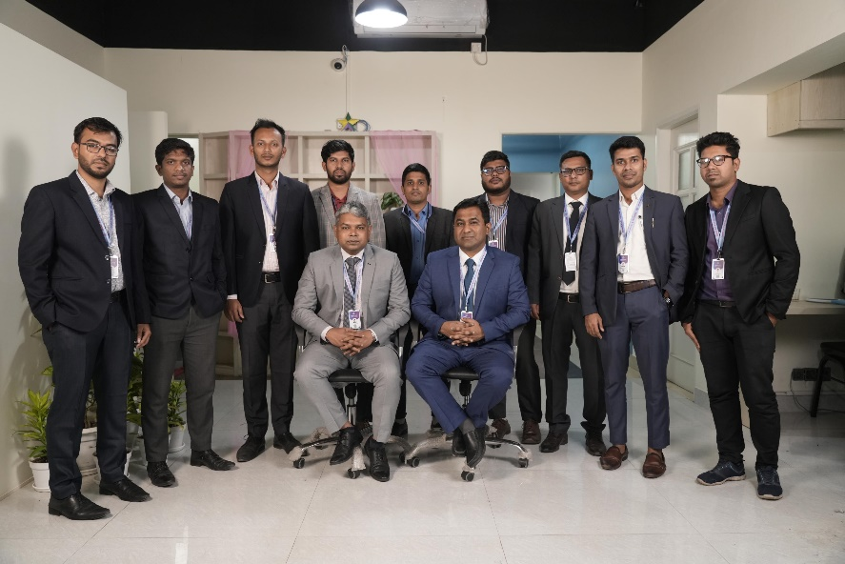
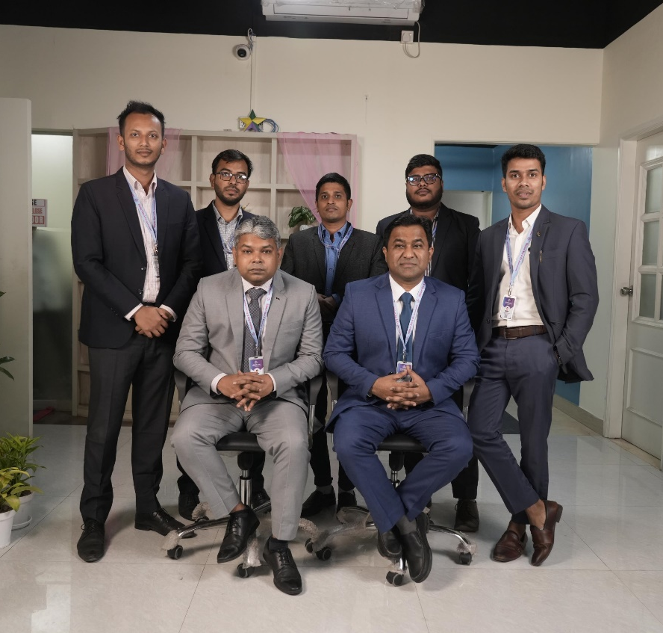
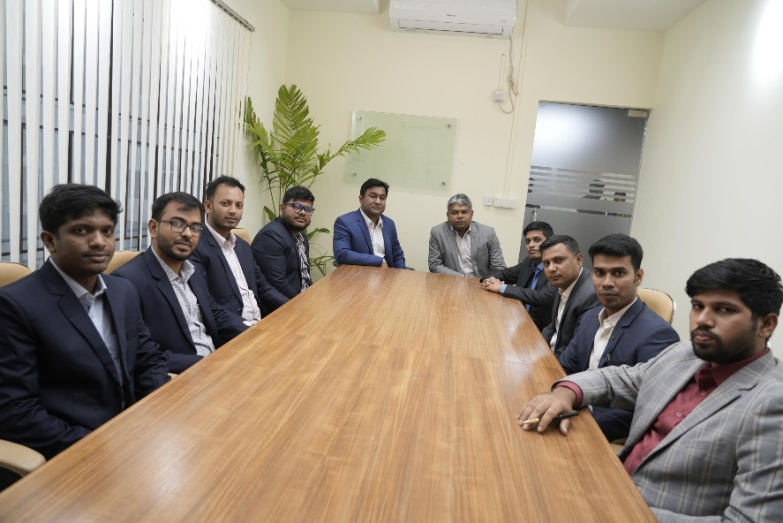
MANAGERS

Slide 15
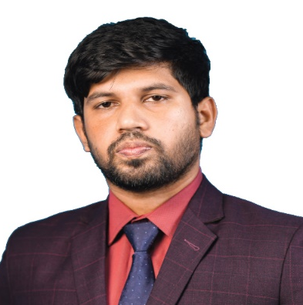
Md. Al-Amin Chaklader
BBA, MBA, CA (Professional Level)
Senior Manager (Audit & Assurance)
Email: alamin@arccabd.com
kdroy1260@gmail.com
Akash Kumar Pramanik
BBA, MBA, CA Partly Qualified
Manager (Audit & Assurance)
Email: akash@arccabd.com
akashpramanik96@gmail.com
Md. Hafijur Rahman Riad
BBA, MBA, CA (Professional Level)
Manager (Audit & Professional Service)
Email: riad@arccabd.com
khanriad.rk@gmail.com
Experience:
Md. Hafijur Rahman Riad is providing Accounts & Auditing services to clients over last five years.
Educational Qualification:
MBA (Accounting) from Govt. Titumir College under Dhaka University.
BBA (Accounting) from Govt. Titumir College under Dhaka University.
Specializations:
Financial Statement preparation, Financial Audit, TDS & VDS Calculation, Payroll & Other Service etc
Experience:
Mr. Al-Amin is working in Accounts, Payroll, TDS, VDS calculation dedicatedly from last five years.
Educational Qualification:
BBA, MBA (Accounting), CA (CC) (Professional Level)
Specializations:
Accounts, Audit, Payroll, TDS, VDS calculation, Assurance & Secretarial Service etc.
Experience:
Mr. Akash kumar Pramanik is working in Auditing, Accounting Services, Company Secretarial Services, with Tax and VAT laws dedicatedly from last five years.
Educational Qualification:
MBA (Accounting) from Stamford University Bangladesh.
BBA (Accounting) from Stamford University Bangladesh.
Specializations:
Accounts, Audit, VAT Assessment, NGO, Assurance & Secretarial Service etc

Slide 16
Obaidur Rahman, MBS, LL.B, ITP
Manager (Tax Circle Office)
Email: obaidur@arccabd.com
Md. Nurunnabi Chowdhury,
BBS, MBA,LLB, CA Partly Qualified
Senior Manager
(VAT, Tax & Regulatory Affairs)
Email: nurunnabi@arccabd.com
nurunnabimd581@gmail.com
Pritam Kumar Das,
BBA, MBA, CA (Partly Qualified)
VAT & Regulatory Manager
Email: Pritam@arccabd.com
kdroy1238@gmail.com
Experience:
Mr. Obaidur Rahman is working in Tax, Accounting & Assurance Department dedicatedly from last Ten years.
Educational Qualification:
MBS from National University of Management.
BBA from National University of Management.
LLB from National University
ITP from the National Board of Revenue (O 00071)
Specializations:
Tax office hearing, tax assessment, appeal procedure etc.
Experience:
Mr. Pritam is working in, Payroll, VAT Department dedicatedly from last five years.
Educational Qualification:
1. BBA from National University of Accounting.
2. MBA from Jagannath University of Accounting.
Specializations:
Accounts, Audit, Payroll, VAT assessment, appeal procedure etc.
Experience:
Md. Nurunnabi Chowdhury is working in Tax, Accounting & Assurance Department dedicatedly from last Ten years.
Educational Qualification:
MBA (Accounting) from Dhaka University.
BBS (Accounting) from National University.
LLB from National University
Specializations:
Tax office hearing, Tax & VAT Assessment, appeal procedure etc.

Slide 17
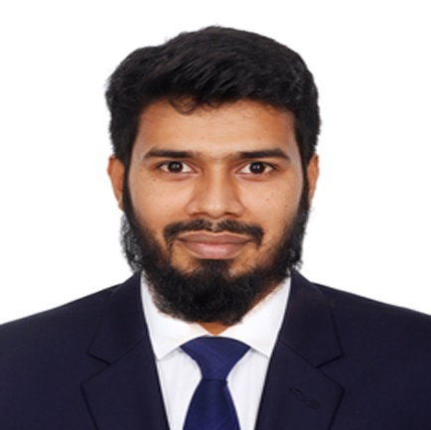
Deep Chandra Das
BBS (Management)
Deputy Manager
(BIDA & Other regulatory services)
Email: deep@arccabd.com
Md. Sabbir Hossain,
BBA, MBA, CA Partly Qualified
(Professional Service)
Email: sabbir@arccabd.com
kdroy1240@gmail.com
Md. Rashed Chawdhury,
BBA, MBA, CA (CC) (Partly Qualified)
Manager (Audit & Assurance)
Email: rashed@arccabd.com
kdroy1237@gmail.com
Experience:
Mr. Sabbir Hossain is working in Tax, Payroll, Accounting & Assurance Department dedicatedly from last three years.
Educational Qualification:
BBA from National University of Finance.
MBA from Jagannath University of Finance.
Specializations:
Tax, Payroll, Accounting, Assurance Service, etc.
Experience:
Mr. Deep is working in Administration Department dedicatedly from the last five years.
Educational Qualification:
BBS from the National University of Management, Department
Specializations:
Administration, Accounts and Billing Service, etc.
Experience:
Mr. Rashed is working in Accounts, Payroll, TDS, VDS calculation dedicatedly from last five years.
Educational Qualification:
BBA, MBA (Accounting), CA (CC) (Professional Level)
Specializations:
Accounts, Audit, Payroll, TDS, VDS calculation, Assurance & Secretarial Service etc.

Slide 18
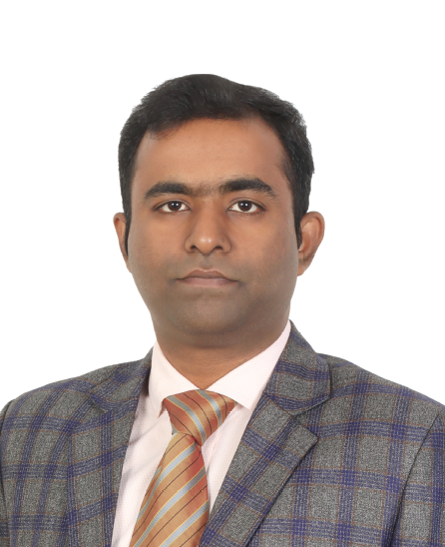
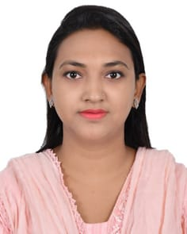
Razu Ahmed
BSC, MSC (Statistics-RU)
Asst, Manager (Admin & Accounts)
Email: razu@arccabd.com
Gennat Jahan
Communication & Administrative Officer
Email: 1991jennatc@gmail.com
Ibrar Hossain
Executive Officer (Admin)
Email: ibrarhossain18@gmail
Experience:
Razu Ahmed working in the Administration & Accounts Department dedicatedly for the last three years.
Educational Qualification:
MSC from Rajshahi University of Statistics.
BSC from Rajshahi University of Statistics.
Specializations:
Administration, Accounts and Billing Service, RJSC, Regulatory, etc.
Experience:
Ibrar Hossain is working in Administration Department dedicatedly from last three years.
Educational Qualification:
MSC from National University of Entomology.
BSC from National University of Zoology.
Specializations:
Administration, Accounts and Billing Service, Regulatory, etc.
Experience:
Gennat Jahan is working in Administration Department dedicatedly from last five years.
Educational Qualification:
MBA from National University of Management.
BBA from National University of Management.
Specializations:
Administration, Accounts and Billing Service, etc.

Slide 19
Major Clients

Slide 20
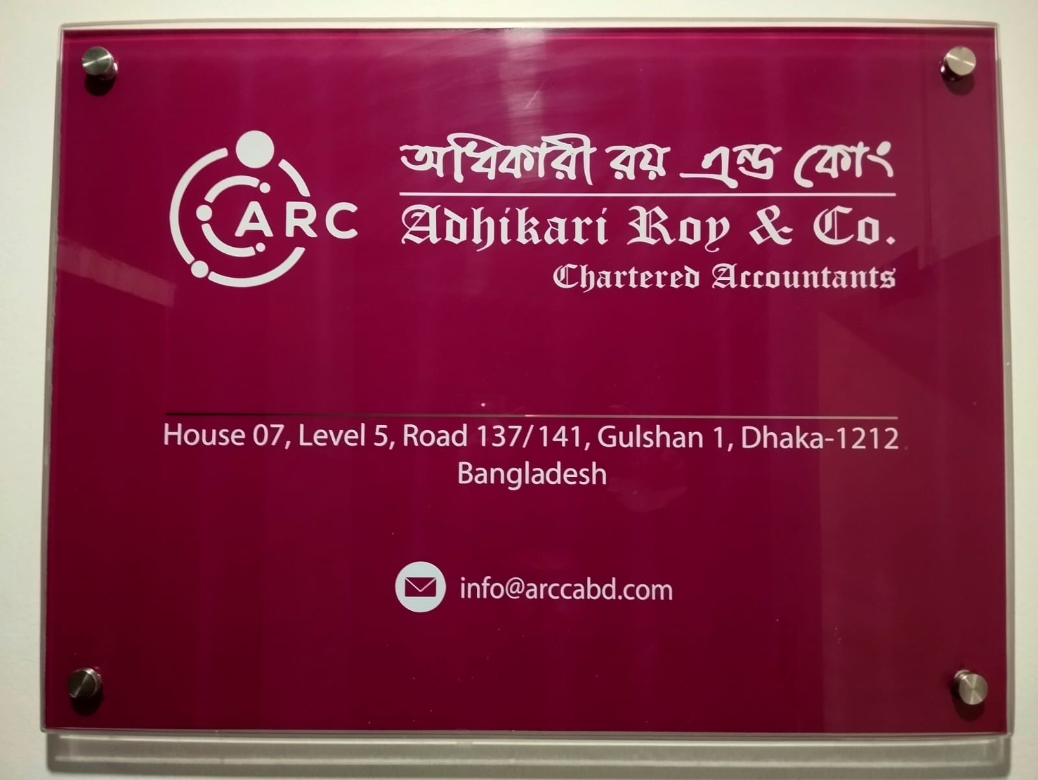
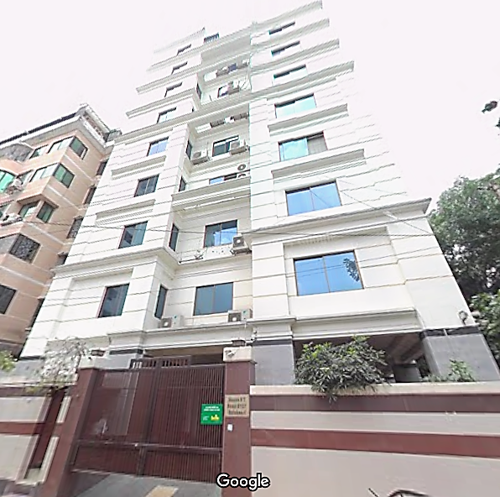
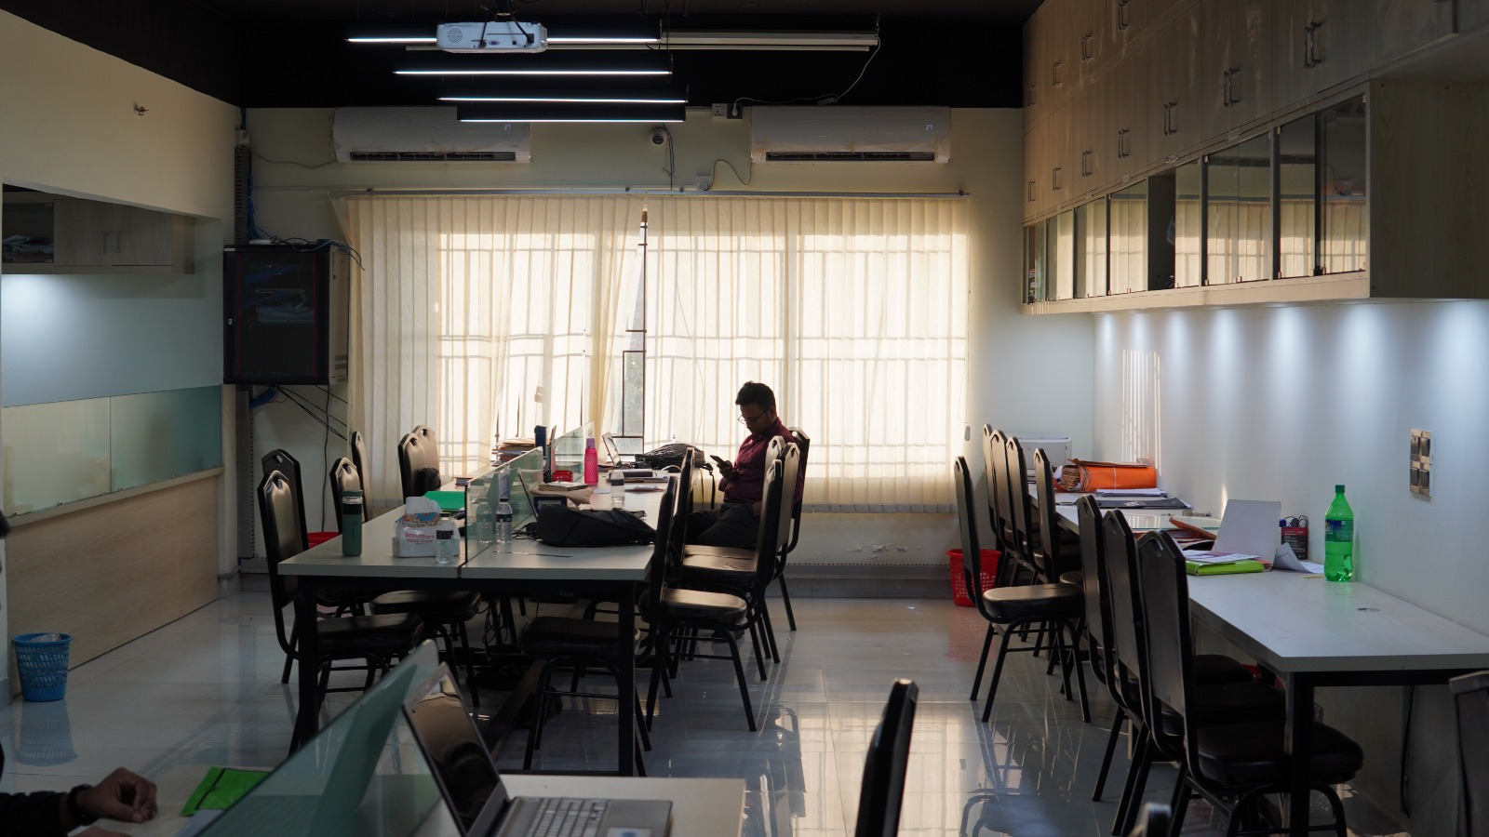
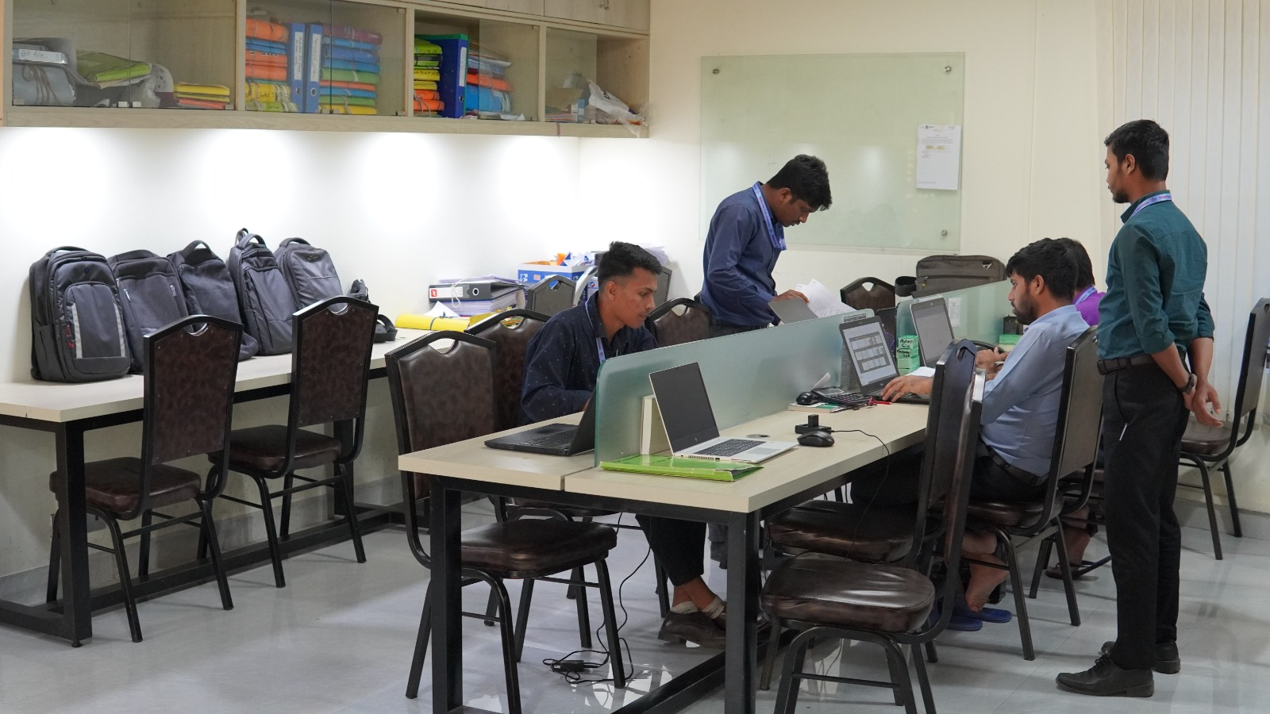
Our Office

Slide 21
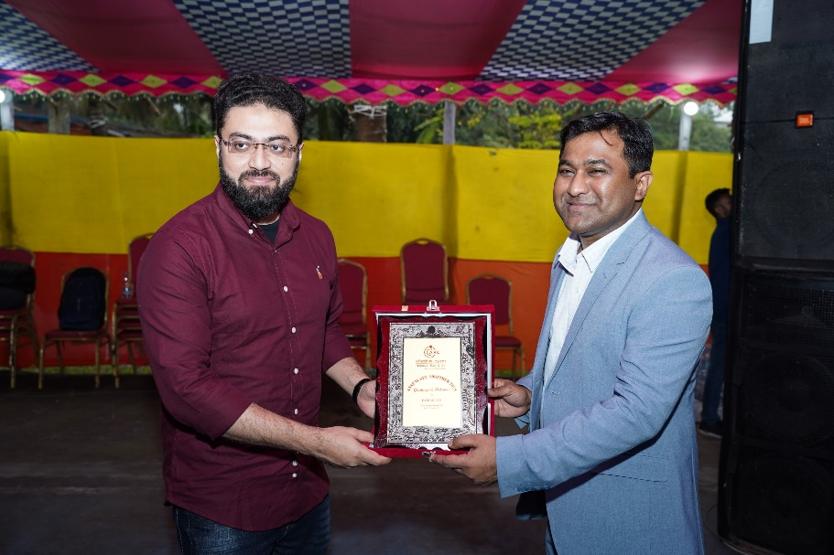
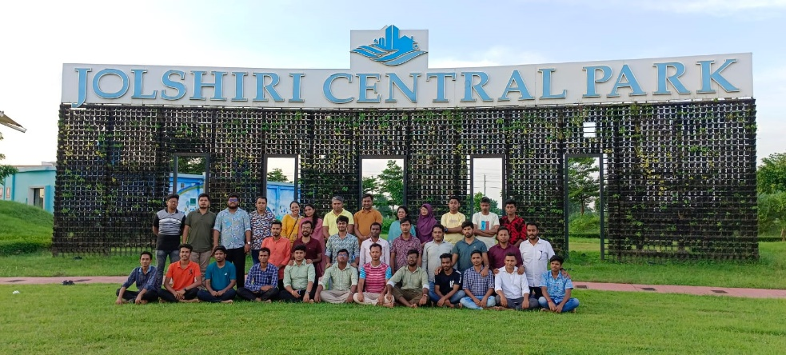
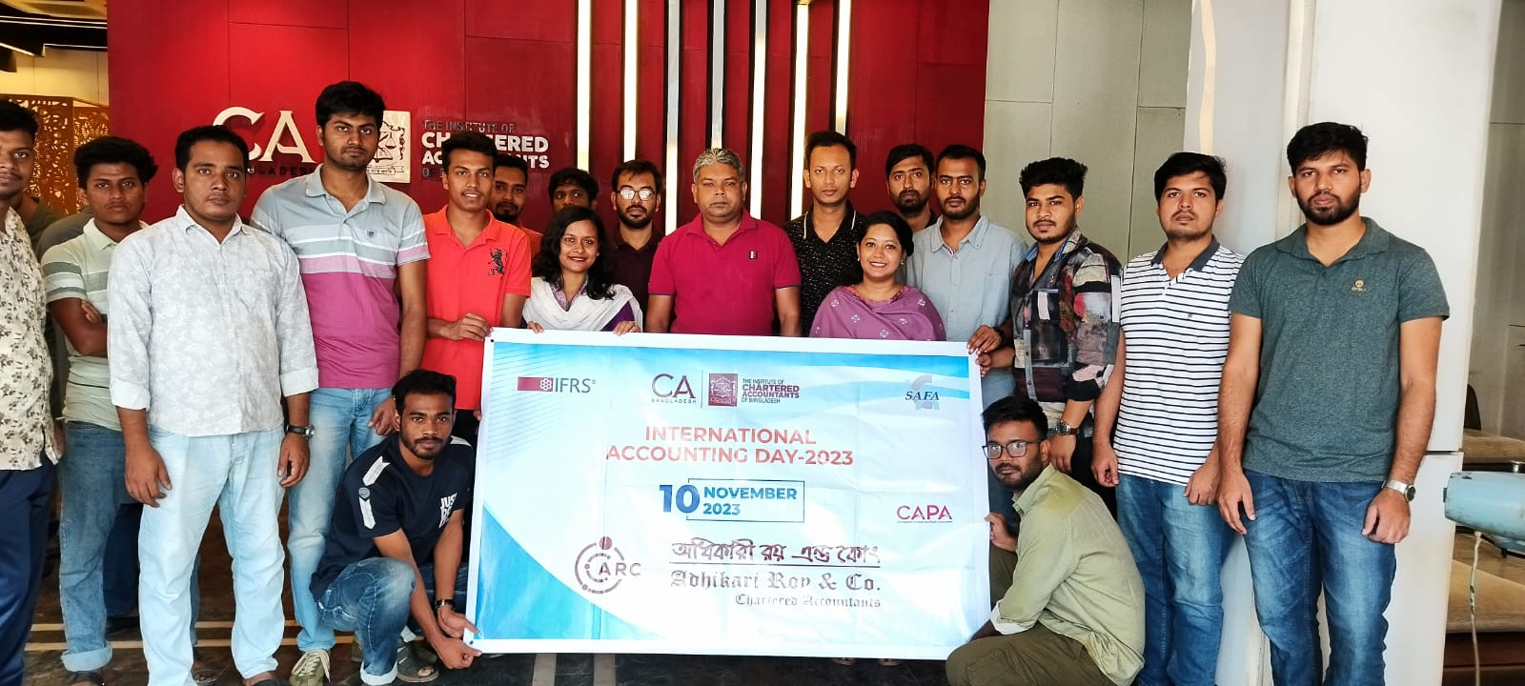
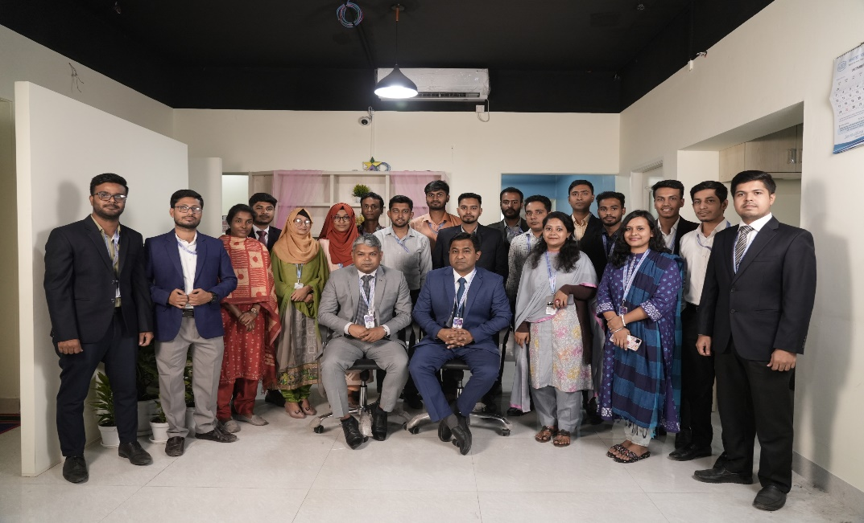
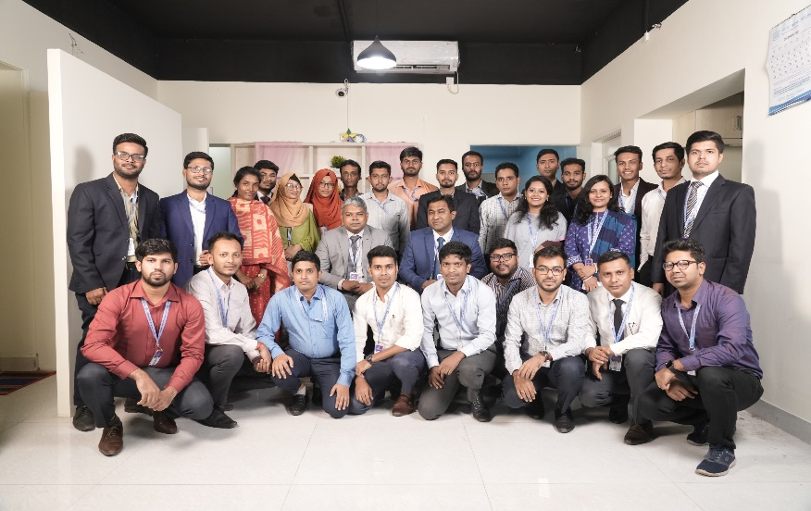
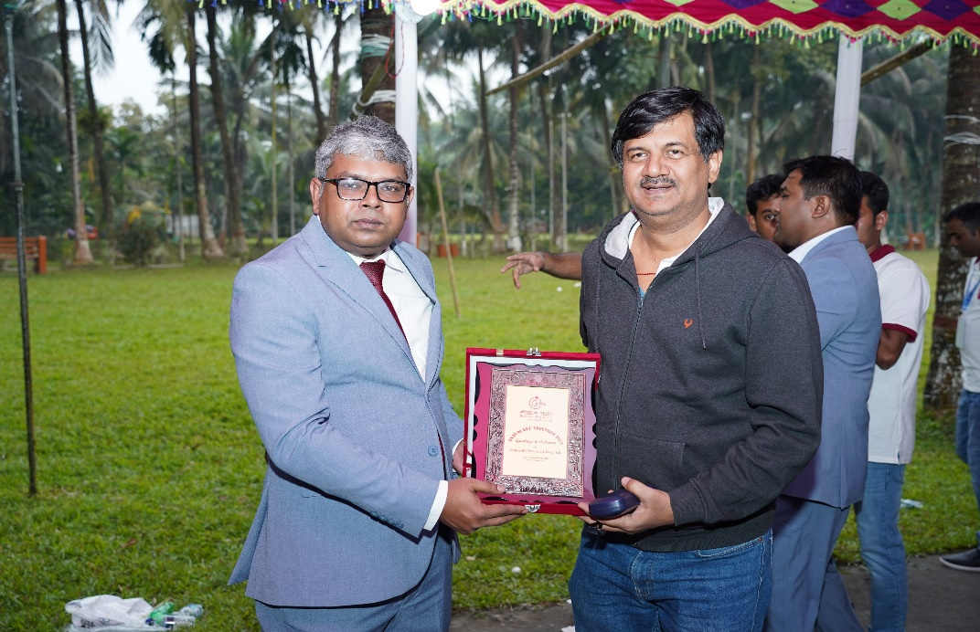
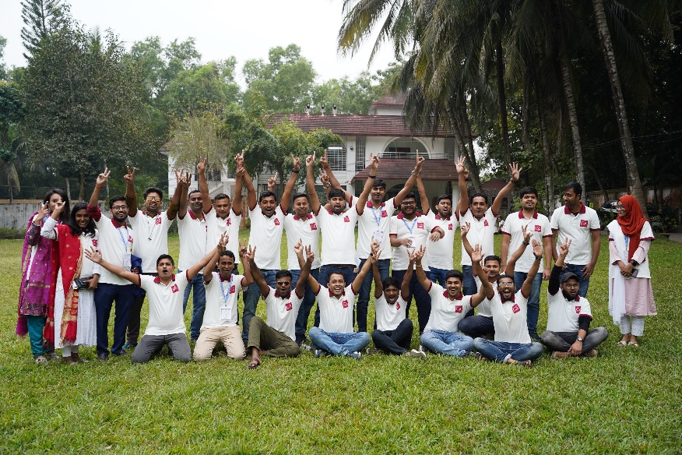
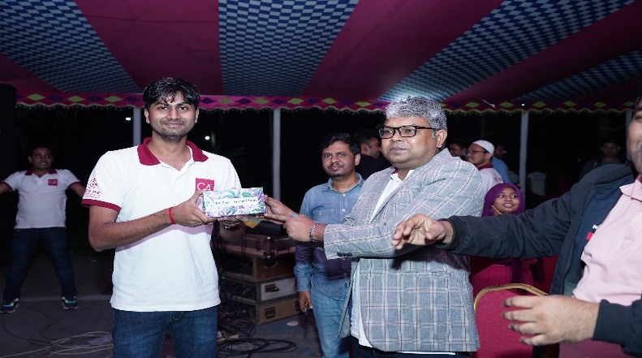
SOME MEMORIES

